Slide 1
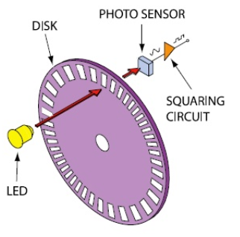
Optical Angular Encoder
Korkut Emre Arslantürk 250206039
Berke Eren 250206008
Melek Tuğçe Çüçen 220206024
[1]
Notes:
Hello my name is Korkut Emre. We are going to talk about our Optical Angular Encoder design.

Slide 2
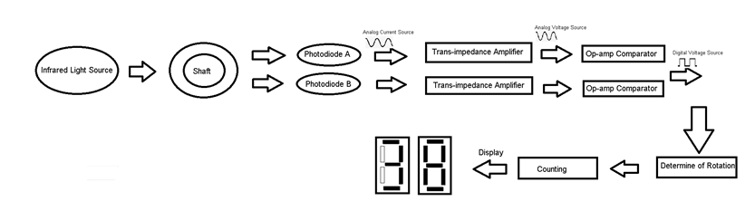
Introduction
Notes:
In this page,we can see block diagram of our project. Our project consists of 3 main parts.
In the first part, thanks to photodiodes, we get a sinusoidal current source from light passing through the shaft. Then we convert current to voltage.
In the second part, we digitalize the analog voltage source to work harmoniously in logic circuits for counting process.
In the final part, using logic circuits, we specify the direction of rotation of shaft. Then, by limiting our counter, we perform the counting process and display it.

Slide 3

Outline
Conversion from Light Source to Voltage Signal
-Light Source and Detection
-Shaft Design
-Current to Voltage Transform
Digitalize of Analog Signal
Counter
-Detection of Direction and Counting
-Limiting and Displaying
Conclusion
Notes:
This is our outline. As I said we have 3 main part. I am going to start with first part, Conversion from Light Source to Voltage Signal

Slide 4

Light Source and Detection
-We used TSAL6100 as a infrared light source.
-We used BPV10NF photodedector.
Notes:
Lets start with light source selection. We use infrared light as a light source for photodiode and detectors to work compatible each other. When choosing a light source and photodiode, we made sure they had the same wavelength, also we select photodiode which has fewer dark current. There is a shaft between photodiodes and the light source that makes a rotational motion. Using 2 photodiodes, we obtain the rays passing through the shaft as two current sources with a phase difference of 90 degrees between them.

Slide 5
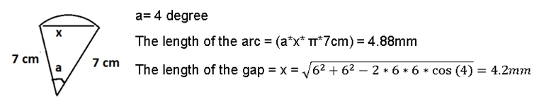
Shaft Design
Notes:
In our circuit our resolution is 8 and our clock signal is 1x. we have three thousand Rpm and our frequency is 50 Hertz . we can specify a radius of 7 cm. Also, we can see the calculation of gap and arc lengths

Slide 6
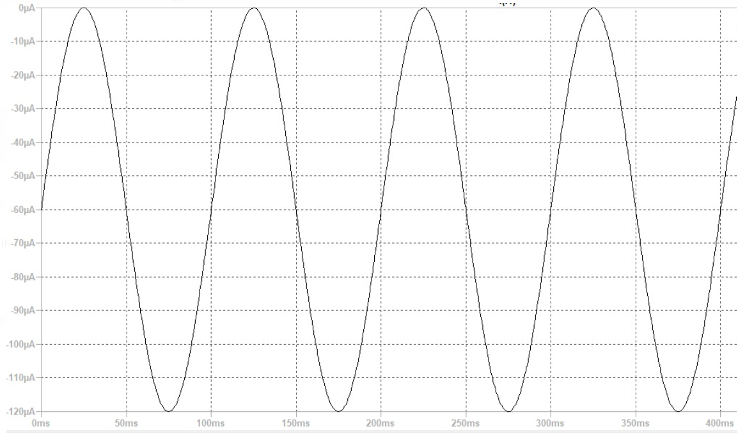
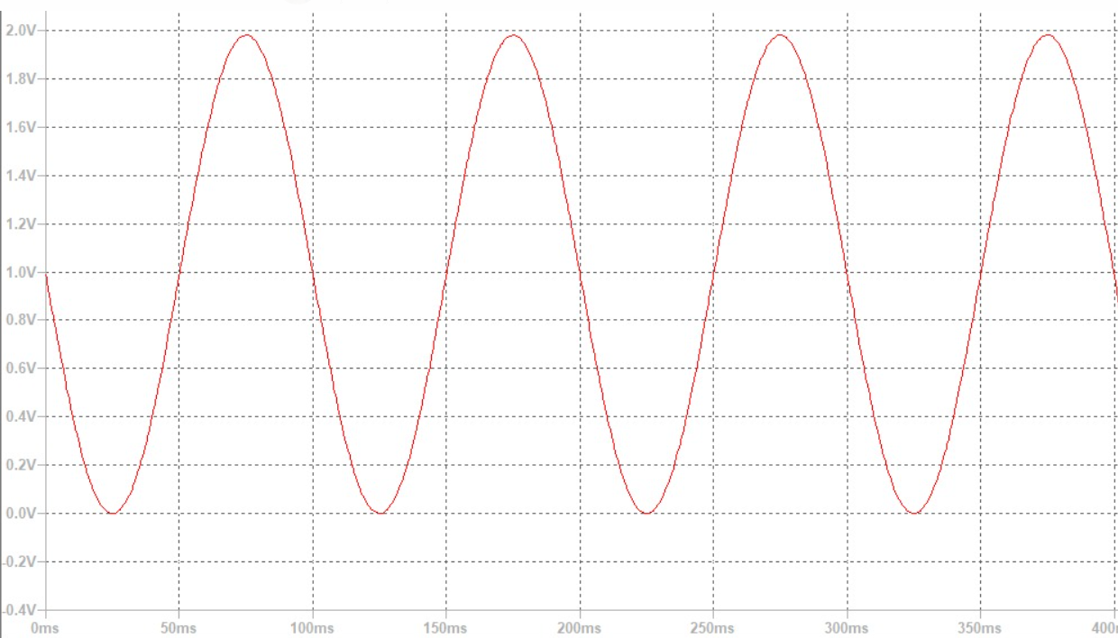
Transimpedance Amplifier
Input Current Source of Trans-Impedance Amplifier
Output Voltage Source of Trans-impedance Amplifier
Notes:
We know the input current and output voltage values what must be. So that we calculated the required capacitor and resistance values according to them. Because the disc is rotating, the photodiode's reverse light current is described as an oscillatory signal.

Slide 7
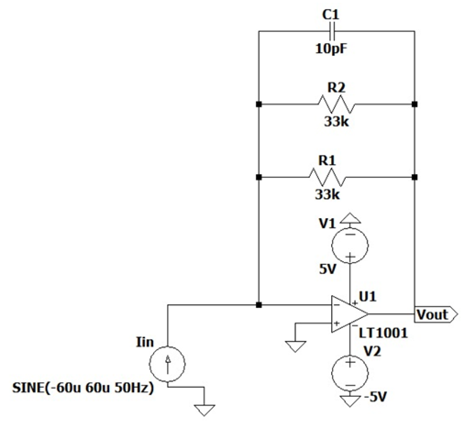
Current to Voltage Transform
Transimpedance Amplifier Circuit
Notes:
Then we convert the analog current sources to the analog voltage sources using the transimpedance amplifier. A transimpedance amplifier transforms current to voltage in the same way as a resistor does, but unlike a resistor, it has low input and output impedance, even when the gain is quite high. We connected the compensation capacitor parallel to the feedback resistance to ensure the stability.

Slide 8
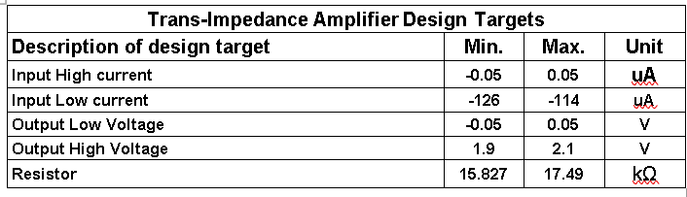
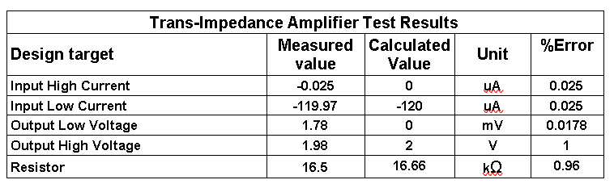
Design Targets and Test Results
Notes:
We have to use standard resistor values which is the closest desired value according to calculation. We have little bit error because of difference between calculated resistor values between standard resistor values.

Slide 9
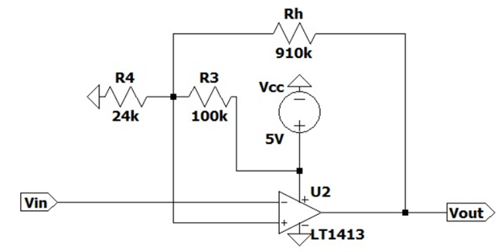
Digitalize of Analog Signal
Comparator Operational Amplifier Circuit
Notes:
Now berke will continue.

Slide 10
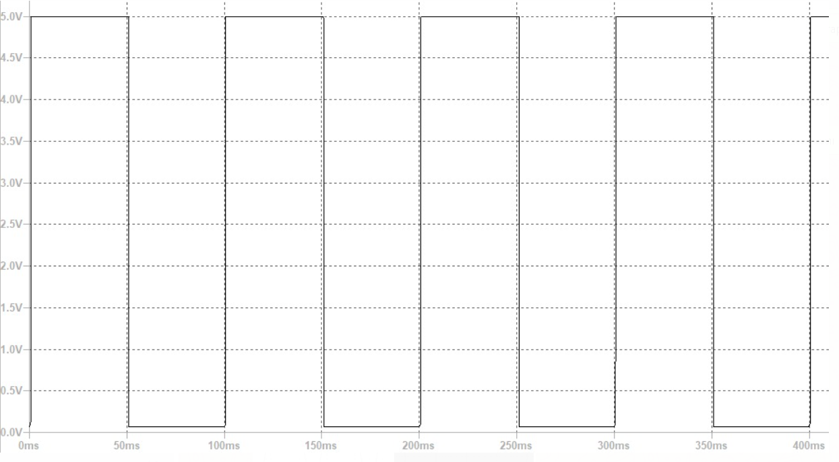
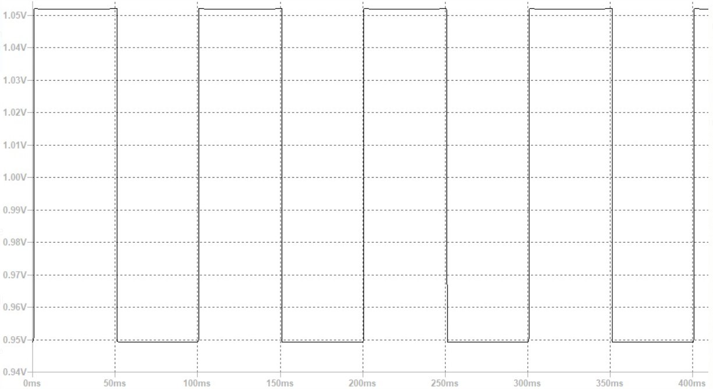
Digitalize of Analog Signal
Output Voltage of Comparator OpAmp Circuit
Threshold Voltage

Slide 11
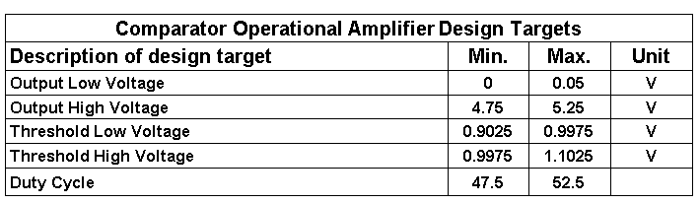
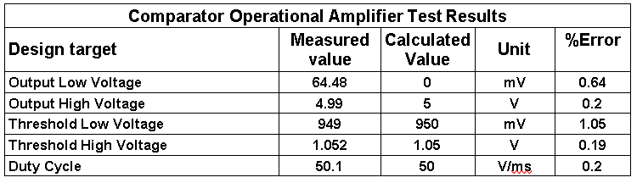
Design Targets and Test Results

Slide 12
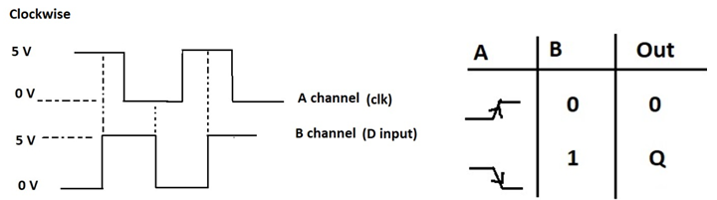
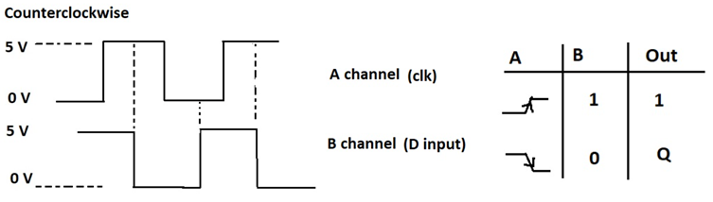
Detection of Direction
We used D flip flop to determine direction.

Slide 13
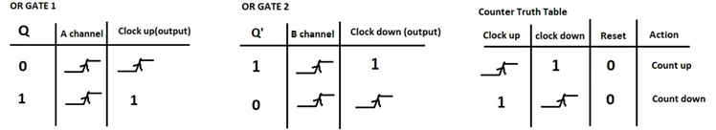
Counting Process
We used 40192 for the counting process.

Slide 14
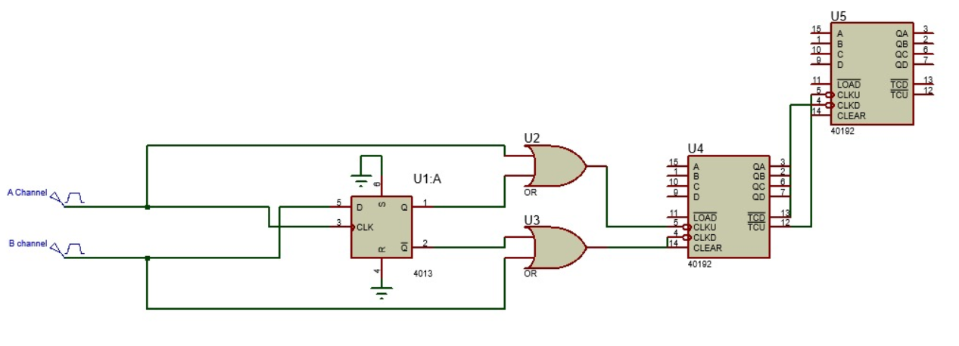
Counting Circuit

Slide 15
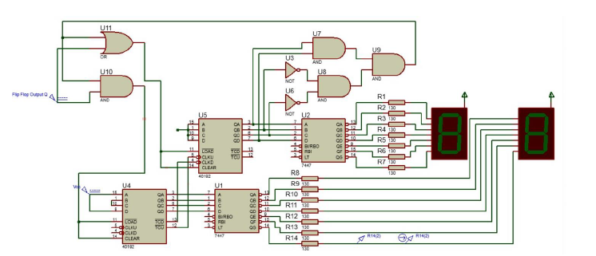
Limiting and Displaying
Counting and Displaying Circuit

Slide 16
LIMITING TRUTH TABLE
Truth Table of Limiting
A | B | C | D | Output
0 | 0 | 0 | 0 | 0
0 | 0 | 0 | 1 | 0
0 | 0 | 1 | 0 | 0
0 | 0 | 1 | 1 | 0
0 | 1 | 0 | 0 | 0
0 | 1 | 0 | 1 | 0
0 | 1 | 1 | 0 | 0
0 | 1 | 1 | 1 | 0
1 | 0 | 0 | 0 | 0
Karnaugh-Map of Limiting
AB/CD | 00 | 01 | 11 | 10
00 | 0 | 0 | 0 | 0
01 | 0 | 0 | 0 | 0
11 | 0 | 0 | 0 | 0
10 | 0 | 1 | 0 | 0
Function of limiting ➔ A.B’.C’.D
1 | 0 | 0 | 1 | 1

Slide 17
DESİGN TARGETS AND TEST RESULTS
Display Design Targets
Description of design target | Min. | Max. | Unit
Forward Voltage | 2.28 | 2.52 | V
Segment of current (If) | 19 | 21 | mA
Resistors between 7447 and 7 segment BCD | 123.5 | 136.5 | Ω
Displaying Test Results
Design target | Measured value | Calculated Value | Unit | %Error
Forward Voltage | 2.4 | 2.35 | V | 2.08
Segment of current(If) | 20 | 20 | mA | 0
Resistors between 7447 and 7 segment BCD | 130 | 130 | Ω | 0

Slide 18

Conclusion

Slide 19
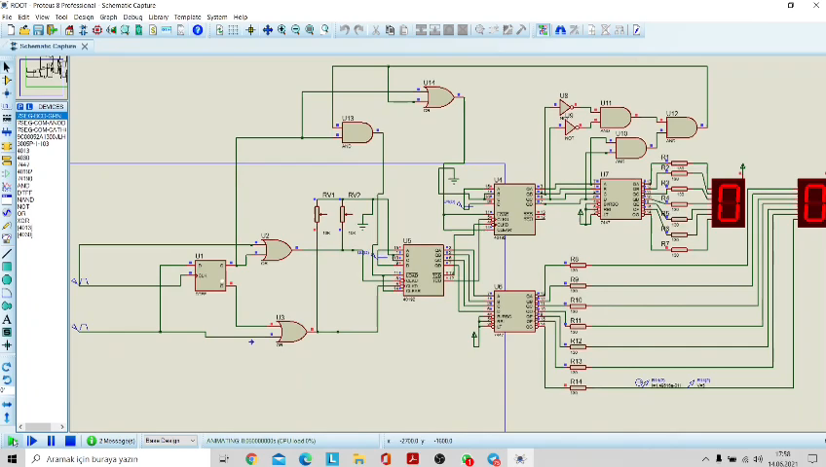
Counting when Shaft rotating clockwise

Slide 20
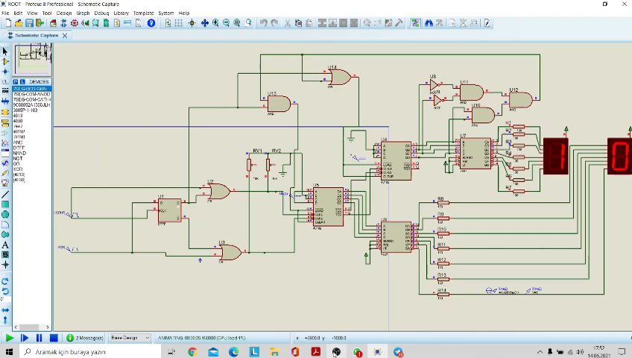
Counting when Shaft Rotating Counterclockwise

Slide 21
Component List
Component description | Part Number | Manufacturer | Supplier
High Power Infrared Emitting Diode | TSAL6100 | Vishay Semiconductors | www.vishay.com
Silicon PIN Photodiode | BPV10NF | Vishay Semiconductors | www.vishay.com
Operational amplifier | LT1001 | Linear Technology | www.digipart.com
Operational amplifier | LT1413 | Linear Technology | www.digipart.com
Dual D-Type Flip-Flop | CD4013 | Fairchild | www.direnc.net
CMOS Presettable BCD Up/Down Counter | CD40192B | Texas Instruments | www.ti.com
BCD to 7-Segment Decoders/Drivers | DM7447A | Fairchild | www.ebay.com
Standard 7-Segment Display | TDSO5150 | Vishay Semiconductors | www.vishay.com

Slide 22

THANKS

Slide 23
Referances
1. Rotary encoder basics and applications, Part 1: Optical encoders
Available: https://www.analogictips.com/rotary-encoders-part-1-optical-encoders/

